Slide 1
Object-Oriented Analysis and Design
Chapter 9:
UML interaction diagrams
introduction to design

Slide 2
What will we learn?
  UML Interaction Diagrams – What are they, how to create them

Slide 3
UML Interaction Diagrams
There are two types: Sequence and Communication diagrams
We will first look at the notation used to represent these, and then later look at important principles in OO design
We’ll look at various examples here to learn how to create the diagrams

Slide 4
UML Sequence Diagrams
Sequence diagrams are more detailed than communication diagrams
They often represent a series of method calls between objects in a system
The sequence is represented in what is called “fence format”, and each new object in the sequence is added to the right in the diagram
Interactions between objects are usually method calls, but may also be object creation/deletion
Especially useful for message flow diagrams, with request-reply pairs

Slide 5
Example: Sequence Diagram
public class A
{
private B myB = new B();
Public void doOne()
{
myB.doTwo();
myB.doThree();
}
}

Slide 6
UML Communication Diagrams
Communication diagrams illustrate object interaction in a graph or network format; objects may be placed anywhere in the diagram

Slide 7
Which is best?
Depends on the situation; sequence diagrams are mostly preferred because they can capture more detail, but communication diagrams are useful for capturing object interaction on whiteboard or wall sketches
  Recall that with Agile UP, much of the design is done at the whiteboard in small groups
In general, more notational tools are available for sequence diagrams, and it is usually easier to read the call flows
Communication diagrams are much easier to edit and change
  Just add in new objects anywhere
Communications diagrams are also much more space efficient
One possible approach: Start with communications diagram, and if needed, then develop sequence diagrams
We only going to use sequence diagrams.

Slide 8
Reading a Sequence Diagram
We would say “The message makePayment is sent to an instance of Register. The Register instance sends the makePayment message to the Sale instance. The Sale instance creates an instance of a Payment.” Here, “message” is a method call.

Slide 9
Interaction Diagrams Are Important
Often left out in favor of class definition diagrams, but these diagrams are important and should be done early
They describe how the objects interact, and may give clues to the operations and attributes needed in the class diagrams

Slide 10
Sequence Diagrams: Lifeline Box Notation
Basic notation for the entities that make up the sequence diagram – they are called lifeline boxes and represent the participants in the particular sequence being modeled
Note that a participant does not need to be a software class, but it usually is for our purposes
The standard format for messages between participants is:
  return = message(parameter: paramerType) : returnType
  Type information is usually omitted, as are parameters

Slide 12
Sequence Diagrams: Messages
Messages are notated as solid arrows with filled in arrowheads between lifelines
  The lifelines are the dotted lines that extend below each participant box, and literally show the lifespan of the participant
The first message may come from an unspecified participant, and is called a “found message”. It is indicated with a ball at the source
Messages can be synchronous (sender waits until receiver as finished processing the message, and then continues – blocking call) or asynchronous (sender does not wait, more rare in OO designs)
Dashed arrow is used to indicate return of control, e.g. after receipt of synchronous message. May contain a value.

Slide 14
Sequence Diagrams: Specifics
The execution specification bar or activation bar indicates that the operation is on the call stack
Usually replies to messages are indicated with a value or a dotted line (see next slide)
It is possible to have a message to “self” (or “this”)
Sequence diagrams can also indicate instance creation (see later slide)
Likewise, instances can be destroyed (indicated by “X” at the end of lifeline)

Slide 17
Sequence Diagrams: Specifics
Diagram frames may be used in sequence diagrams to show:
  Loops
  Conditional (optional) messages
  Nesting (a conditional loop)
  Relationships between diagrams
See next slides for examples

Slide 22
Polymorphism
Polymorphism – inheriting an operation from a superclass
  Can show this by first showing the message to the abstract class, and then breaking out individual diagrams for the sub-classes

Slide 24
Object-Oriented Analysis and Design
Chapter 9:
UML interaction diagrams
introduction to design

Slide 25
Analysis vs Design
  A bad domain model will mean bad communication of the what the system is; a bad design model often leads to a bad implementation
  Making the correct choices now becomes more important
    Here is where iterative development can help – constant feedback and requirements enhancement can help the design evolve correctly
  Note the initial requirements analysis phase may be very short, and of course coding can start immediately

Slide 26
Designing Objects
There are two kinds of object models: dynamic and static
Dynamic models help design the logic (i.e. the behavior) of the code or methods
  These are the UML interaction diagrams (sequence or communication) we have seen
Static models help design the definition of packages, class names, attributes, and method signatures or operations (names and input parameters, return values – not method bodies)
  These are the UML Class diagrams
Both types of models are usually created together in Agile UP
  Can start with dynamic model and then move to static to fill in details
Dynamic models tend to be more challenging and useful – they explain the behavior, and will reveal the software objects that need to exist to make the behavior happen, as well as the messages/methods that allow these objects to communicate

Slide 27
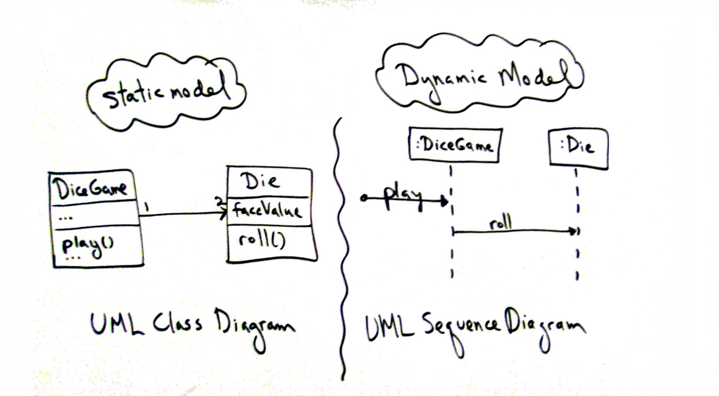

Slide 28
Designing Objects (cont.)
It is during the dynamic model creation stage that responsibility-driven design principles (like GRASP) are used
Recall that one the critical aspects of OOD was how to assign responsibilities to the objects in our design – this is essentially what the GRASP principles help with
Basic process: For each system event, create software classes (using the Domain Model for inspiration) that will be responsible for handling the event
For static models, the most common tool is the UML class diagram
  Often created in parallel with the dynamic models
  Organized into packages, as we have already seen
Remember, UML is a tool, not the actually design skill. Anyone can draw a UML diagram, but creating a good OO design is more challenging

Slide 29
Object-Oriented Design: Overview
Start with the use cases, Domain Model (possibly),
Select a system operation
Using design patterns (like GRASP or GoF), or general experience, create software classes that will allow the system to handle the responsibilities of the system operation
  Usually start with a dynamic model, like an sequence diagram
  The operations contract or use case will describe the “responsibilities” – i.e. what the system is supposed to do, or what changes in the system
  Use the Domain Model to inspire software objects that will create the desired behavior

Slide 30
Design Patterns: Introduction
In software engineering, a design pattern is a general reusable solution to a commonly occurring problem
Note: Not a code template or a reusable module
These are descriptions for how to solve a problem
The problems addressed by design patterns are commonly occurring problems in software design
We will study two groups in this course:
  GRASP: General Responsibility Assignment Software Patterns (or Principles)
  GoF: Gang of Four Patterns, widely considered the fundamental patterns for OOD
These will provide us with guidance on how to assign responsibilities to objects we want to design

